Slide 1
Ilya Vladimirskiy

Slide 2


How can I help you?
Third semester at ReDI
Intro to Python, winter 2017
Intro to Python, spring 2018
Intro to Programming with Python, winter 2018
Data Engineer at Smartfrog (IoT Startup)
Python, SQL
Everything around data

Slide 3

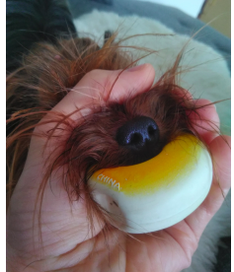
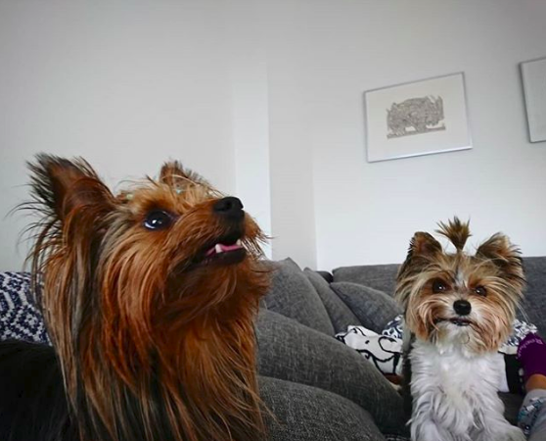
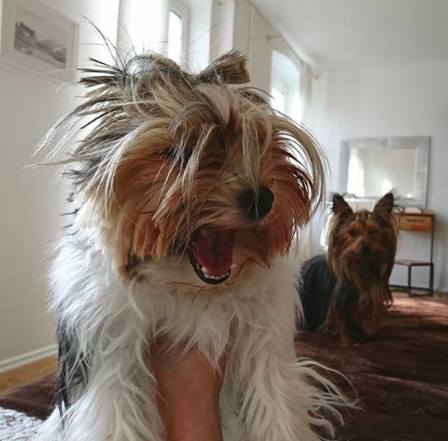
What do I do, except work?
Billiard
Training my dogs

Slide 4
Contacts
Slack
Email: bkmy43@googlemail.com
LinkedIn: https://www.linkedin.com/in/ivladimirskiy/

